Slide 1

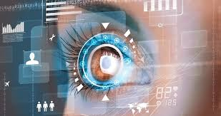
EyeSense AI
Eye Dieases Detection Using Deep Learning Model
Presentation
SMSC2425201_Sheetal More

Slide 2

Table Of Contents
1
2
3
Introduction
5
Literature Review
Abstract
4
5
6
Data Collection
Methodolody
Model Deployment

Slide 3
Table Of Contents
9
8
7
4
Development Startegy
Evalution Metics
Conclusion

Slide 4

Introduction
Eye diseases such as diabetic retinopathy, glaucoma, cataracts, and age-related macular degeneration (AMD) are among the leading causes of vision impairment and blindness worldwide, affecting millions of people across different age groups. Early detection plays a crucial role in preventing irreversible vision loss, but traditional diagnostic methods rely on manual examination by ophthalmologists, which can be time-consuming, prone to human error, and challenging to scale, especially in regions with limited medical expertise. The integration of Artificial Intelligence (AI) in medical imaging has revolutionized disease detection by enabling automated analysis of retinal images. Deep learning, particularly Convolutional Neural Networks (CNNs), has shown remarkable accuracy in identifying patterns and anomalies in medical images, allowing for faster and more reliable diagnoses. This advancement in AI-driven diagnostics has the potential to enhance accessibility, improve efficiency, and ultimately reduce blindness rates through early intervention.

Slide 5

Abstract
Eye Dieases like cataracts, diabetic retinopathy, and glaucoma are leading causes of vision impairment and blindness. Early detection is crucial but limited by the need for specialized expertise and equipment.
This research proposes a deep learning-based automated system for eye disease classification using retinal fundus images.
Various models, including CNN, Xception, InceptionV3, and VGG19, were evaluated, with CNN achieving the highest accuracy (85%). A Kaggle dataset was preprocessed using normalization, resizing, and data augmentation to enhance model performance.
The system is deployed as a Flask-based web application for real-time disease prediction. This AI-driven approach offers a cost-effective, efficient, and accessible solution for early eye disease detection, improving healthcare accessibility and patient outcomes.

Slide 6
literature Review
Deep Learning in Medical Imaging
CNNs outperform traditional machine learning in medical image classification (LeCun et al., 2015).
Deep learning models achieved high sensitivity and specificity in detecting diabetic retinopathy (Gulshan et al., 2016).
CNNs for Eye Disease Detection
VGG19, InceptionV3, Xception, and Custom CNNs have been widely used in ophthalmology.
Studies show CNNs improve accuracy in retinal disease classification when combined with data augmentation (Akram et al., 2019).
Performance Comparison of Models
CNN achieved 96.6% accuracy in detecting multiple retinal diseases (Kermany et al., 2018).
Your Study (2024): CNN (85%) outperformed VGG19 (45%), Xception (55%), and InceptionV3 (35%).
Challenges in AI-Based Eye Disease Detection
Data limitations, high computational costs, black-box interpretability, and regulatory challenges hinder clinical adoption (Rajpurkar et al., 2018).

Slide 7
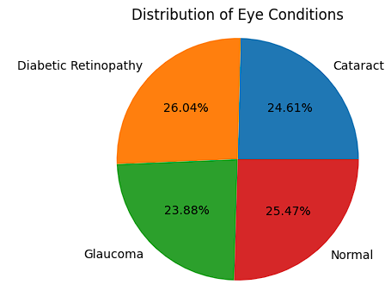

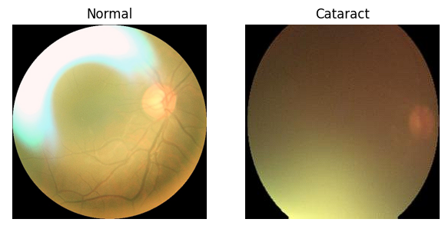

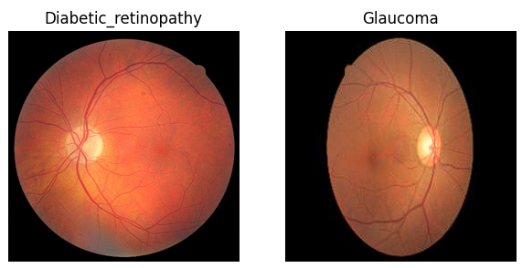

Data Collection
Data Collection & Preprocessing
Dataset Source: Kaggle
Total Images: 4,217 retinal images
(4 disease categories: Cataract, Glaucoma, Diabetic Retinopathy, Normal)
Dataset Characteristics
Types of Images:
Fundus images (Retinal scans)
OCT scans (High-resolution cross-sections)
Retinal scans (Detailed eye structure analysis)
Preprocessing Steps
Image Resizing: 256×256 pixels
Normalization: Pixel values scaled between 0 and 1
Data Augmentation: Rotation, flipping, brightness adjustment
What we do?

Slide 8

Methodolody
Model Architecture & Optimization
CNN Architecture:
Input layer processes preprocessed eye images.
Convolutional layers extract features using filters (ReLU activation).
Pooling layers (MaxPooling) reduce dimensionality while preserving key features.
Fully connected layers classify images using Softmax.
Data Augmentation:
Techniques: Rotation, flipping, brightness adjustments, zooming.
Enhances dataset diversity and prevents overfitting.
Loss Function:
Categorical Crossentropy measures prediction accuracy for multi-class classification.
Optimizer:
Adam optimizer dynamically adjusts learning rate for efficient and stable convergence.
Hyperparameter Tuning:
Optimized learning rate, batch size, dropout rate, and number of filters for better accuracy.
Comparison with Other Models:
CNN outperforms ML models like Vgg19,Inecpetion,Xecption and CNN in image classification.

Slide 9

Models & Accurancy
1.Convolutional Neural Networks (CNN - Generic)
A basic CNN is the foundation of all the other models mentioned.
It uses convolutional layers to extract spatial features from images.
It is simple and effective for image classification and recognition.
Accurancy- 0.8573
2. VGG19
VGG19 is a deep CNN with 19 layers (16 convolutional + 3 fully connected).
It has a very simple architecture (stacked 3×3 convolution layers).
It performs well in transfer learning (pretrained on ImageNet).
Accurancy-0.7551
3. Inception (GoogLeNet)
Inception uses multi-scale convolutional filters in parallel, reducing computational cost while capturing features at different levels.
It has 1x1 convolutions for dimensionality reduction, making it more efficient than VGG.
It is designed for deeper networks without increasing parameters too much.
Accurancy- 0.7360
4.Iception (Extreme Inception)
Xception is an improvement over Inception that replaces standard convolutions with depthwise separable convolutions (more efficient and powerful).
It reduces computation while maintaining high accuracy.
It removes the fully connected layers, improving generalization.
Accurancy-0.7372

Slide 10

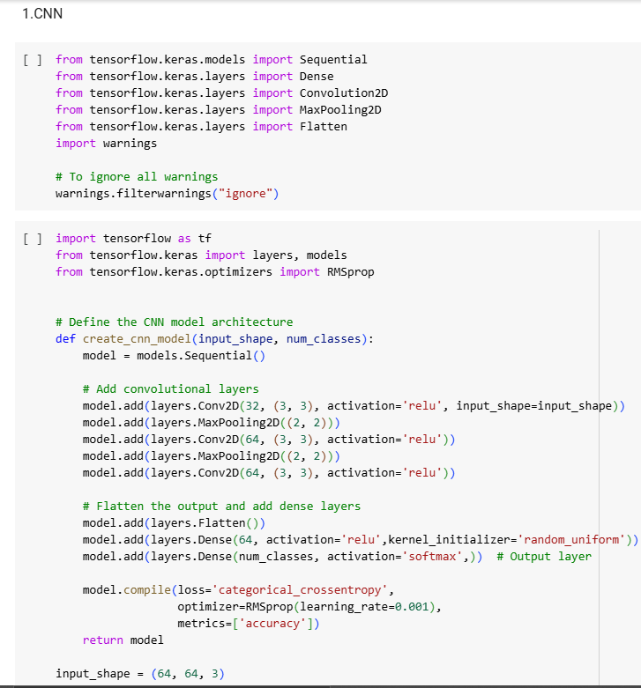
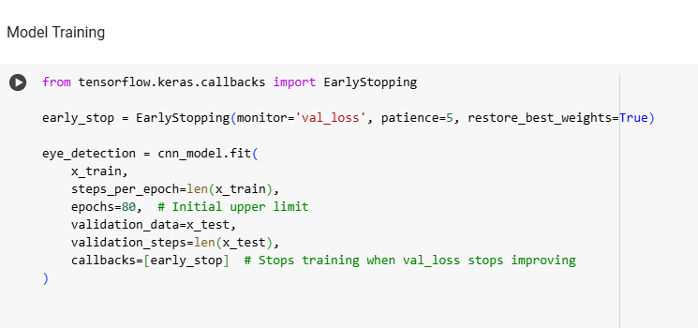
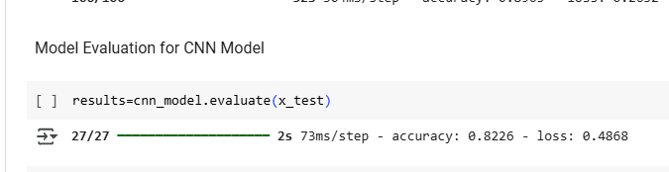

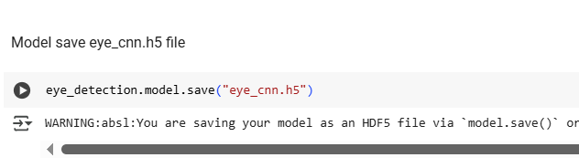
Model Used for project- CNN Model

Slide 11
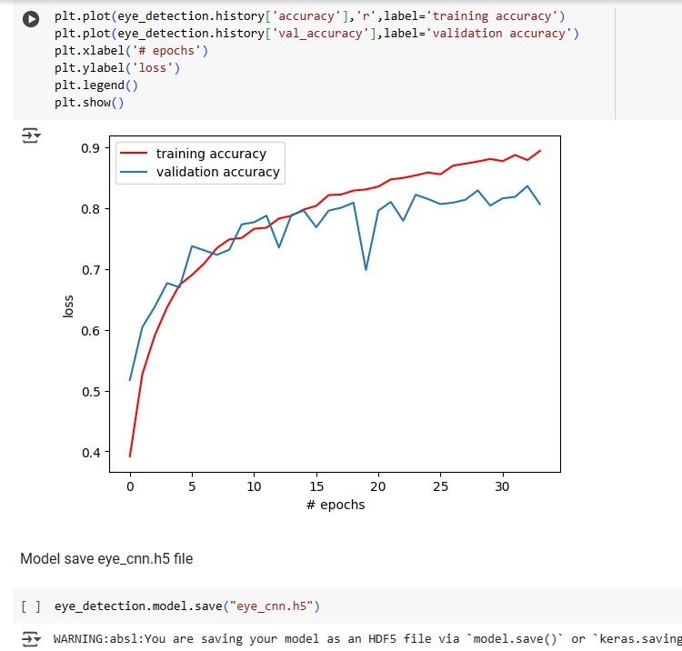
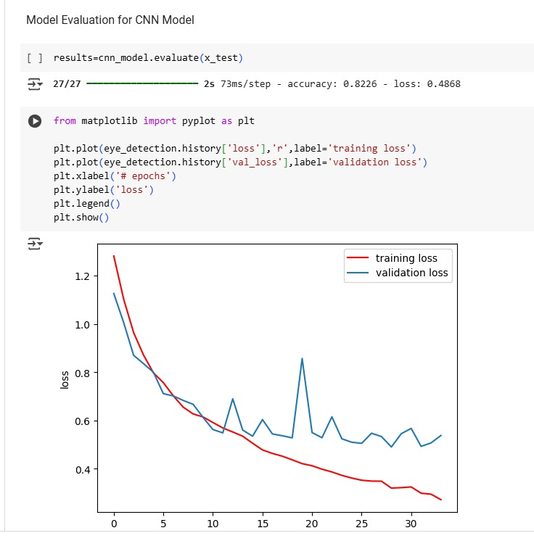
Evaluation Metrics
Training vs Validation Loss chart shows how well the model is learning and how it performs on unseen data. The training loss (red line) decreases steadily, indicating that the model is learning from the training images. However, the validation loss (blue line) fluctuates and increases after some point, which is a sign of overfitting the model is memorizing the training data instead of learning patterns that would help it perform well on new, unseen images.
Training vs Validation Accuracy chart tracks how accurately the model predicts both training and unseen images. The training accuracy (red line) steadily improves, showing the model is learning to classify the training images correctly. However, the validation accuracy (blue line) fluctuates after some initial improvement, indicating that the model struggles to maintain consistent performance on new images, suggesting it may be overfitting to the training data.

Slide 12
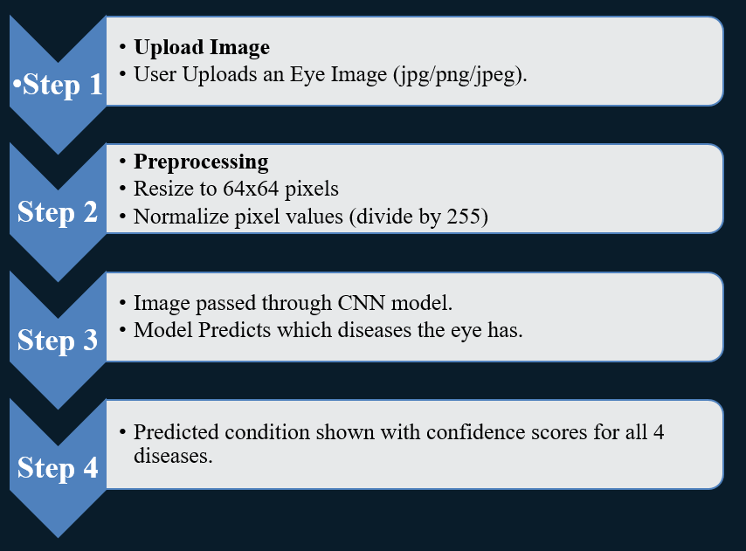
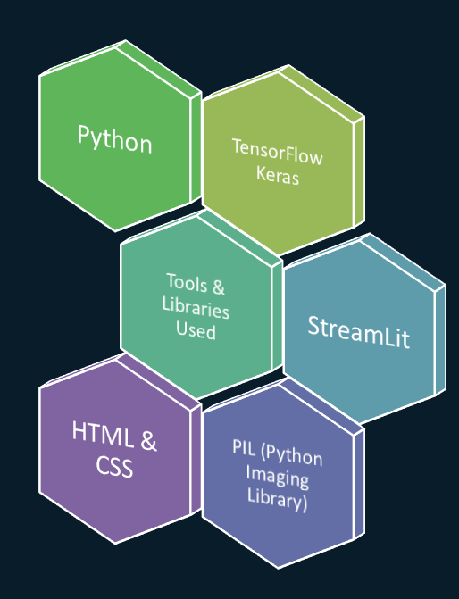
How CNN Works?

Slide 13

Development Strategy:
Deployment Strategy & Working
Cloud Hosting:
Model hosted on Google Colab for scalability and faster processing.
Flask-Based Deployment:
Flask is used to create a web-based interface for eye disease prediction.
Model Loading:
CNN model (.h5 file) loaded into Flask using TensorFlow/Keras.
Classifies uploaded eye images into four disease categories.
Web Interface Development:
Built using HTML, CSS, JavaScript for user-friendly image upload.
Image Processing & Prediction:
Uploaded image is resized, normalized, and processed before classification.
Model returns disease category with a confidence score.
Results & Accessibility:
Prediction displayed on the web interface.
Flask server runs locally or is deployed on cloud for global access.

Slide 14

Conclusion
Automated eye disease detection using deep learning marks a major advancement in medical image analysis.
Dataset sourced from Kaggle, categorized into cataract, glaucoma, diabetic retinopathy, and normal cases.
Deep learning models (CNN, Xception, InceptionV3, VGG19) were evaluated for classification accuracy.
CNN achieved the highest accuracy (85%) on the validation set.
The model was deployed using Flask for real-time disease prediction via a user-friendly web application.
This system enhances early detection, aids healthcare professionals, and demonstrates the potential of AI in revolutionizing medical diagnostics.

Slide 15
Limitation
Despite achieving high accuracy, the model has certain limitations:
Need for Larger Datasets – The performance of deep learning models heavily depends on the quality and diversity of training data. A more extensive and diverse dataset would improve generalization and prevent overfitting.
Potential Biases – The model may perform differently across various populations, imaging devices, and healthcare settings due to dataset imbalance. Biases in training data can affect prediction reliability.
Limited Interpretability – CNN models are often seen as black boxes, making it difficult for medical professionals to interpret the reasoning behind predictions

Slide 16

Future Scope
Future Scope
Future Improvements
To enhance the model’s effectiveness and scalability, the following improvements are proposed:
Integration with Real-Time Diagnostic Systems – Connecting the model with hospital diagnostic tools and electronic health records (EHRs) will enable real-time clinical decision support.
Mobile Application Deployment – Developing a mobile-friendly app will allow users to capture and analyze retinal images directly from smartphones. This will increase accessibility, especially in remote or underserved areas.
Continuous Model Retraining – Implementing a system for continuous learning will allow the model to be updated with new labeled data, improving accuracy and adaptability to different imaging conditions.
Explainable AI (XAI) Integration – Enhancing model transparency by incorporating visual heatmaps (Grad-CAM) and other explainability tools to help medical professionals understand predictions.

Slide 17


